Slide 1
Testing Video and Audio Quality
Training Session for GL QA
Aya Arlosoroff Segal
Jan 27 2018

Slide 2
Contents
Intro – SVC
Video Quality
Determining video quality
Common video quality issues, troubleshooting and reporting
Examples
Audio Quality
Common audio quality issues, troubleshooting and reporting
Jitter Buffer
Audio Codec Negotiation
Statistics Dialog
Router Statistics Page
Examples

Slide 3
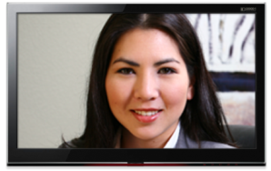

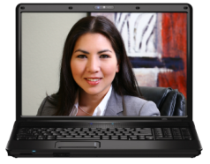


Intro - SVC
High Resolution Layer
Base Layer
High Resolution - High Frame Ra
Source
High Resolution - High Frame Rate
2 Mbps
High Resolution Layer
High Resolution Layer
VidyoRouter™
Base Layer
Base Layer
Medium Resolution - Medium Frame Rate
Medium Resolution - Medium Frame Rate
500 Kbps
Base Layer
3G/4G
Low Bandwidth
Low Resolution - Low Frame Rate
Low Resolution - Low Frame Rate
For more information

Slide 4
Determining video quality
How do we measure video quality of a call?
Encoded/decoded (and rendered) resolution and FPS (frames per second)
Encode/decode bitrate
Number of tiles and tiles appearance
Artifacts
Limiting factors
Available bandwidth and overall health of the network (packet loss, jitter, latency)
Machine capabilities
Camera capabilities

Slide 5
Common video quality issues – i.e what to look for:
Low resolution and low frames per second
Bitrate that is too low or too high in any given resolution/FR
Lip sync issues
Blurry tiles
Black tiles
Tearing (vertical and horizontal lines on the video tiles)

Slide 6
Troubleshooting Low resolution and low frames per second
One of the most common video quality issues is low resolution and frame rate. These can be expected when there is a network issue or a CPU issue, or these can be due to a defect in the product.
What steps should we take when we see an issue with resolution or frame rate?
Check the statistics page. Is what we are seeing reflected in the stats as well?
Check logs to see if there is a resource constraint (network or CPU)
Check whether other participants in the call are seeing the same issue
Check the router page, do the router stats reflect what is seen on the endpoint?
If possible, try with another endpoint on the same machine

Slide 7
Reporting Video Quality Bugs
Always report any video quality issue unless you are 100% certain that there is a reason for the low quality
Information that should be included in a bug report:
Logs from the participant that encountered the issue and all other participants that are relevant (sender and receiver)
Exact timestamp when the issue occurred
Screenshots of stats page from sender and receiver
Screenshots of router page

Slide 8
Common Audio Issues – i.e what to listen for
Voice Distortion
Echoed Voice
Garbled Voice
Choppy Voice
Clipped Voice
Robotic Voice/Synthetic Voice
Underwater Voice
Volume Distortion
Fluctuating Voice
Fuzzy Voice
Loud Voice
Muffled Voice
Soft Voice
Tinny Voice
Loss of audio (capture or playback)
Background Noise when switching capture device

Slide 9
Troubleshooting Device Management
Another type of audio quality issues are problems with device management. A user might unplug their headset and no longer send or receive audio. Or a user might switch to another device during a call and the other participants will begin to hear severe background noise or echo.
To test for device management issues we should do the following:
Change microphone and make sure no background noise is experienced by other participants
Change microphone/speaker while another participant is speaking and make sure no echo is heard
Unplug/switch microphone and speaker and make sure all participants can hear/be heard.

Slide 10
Troubleshooting and Reporting Audio Quality Issues
Choppy Audio - Sometimes choppy audio is normal, if there is severe packet loss in the network. However, if there are no obvious network issues then any choppiness warrants reporting a bug.
Choppy audio can be caused by a jittery network. When reporting an issue get the jitter buffer size.
When reporting lip sync issues, always mention whether audio or video where first.
When troubleshooting any audio quality issue try to isolate the problem by muting all participants and unmuting one by one, or have all participants leave and add them one by one back to the call.
When reporting audio issue, the following log levels should be elevated:
info@LmiAudioCapturer
info@LmiAudioPlayback
info@LmiAudioProcessing
info@LmiAudioBuffer
info@SpeexDecoderPlugin/info@SpeexEncoderPlugin/info@opusDecoderPlugin/info@opusEncoderPlugin

Slide 11
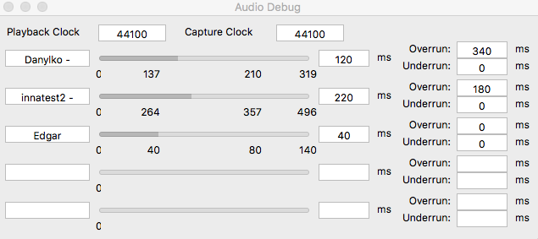
Jitter Buffer
One of the key factors which has an impact on the overall voice quality in video conferencing is the ability to compensate for network jitter. This is principally done by using a jitter buffer which should be realized such that it adapts to the packet transmission characteristic observed in a given transmission link. The depth of the jitter buffer should be adapted to the ongoing packet transmission characteristics. If a high network jitter is observed, the size of the jitter buffer should be long enough to compensate for the network jitter and packets arriving in the wrong order. If a low network jitter is observed the employed jitter buffer should be shorter to minimize the end-to-end signal delay.

Slide 12
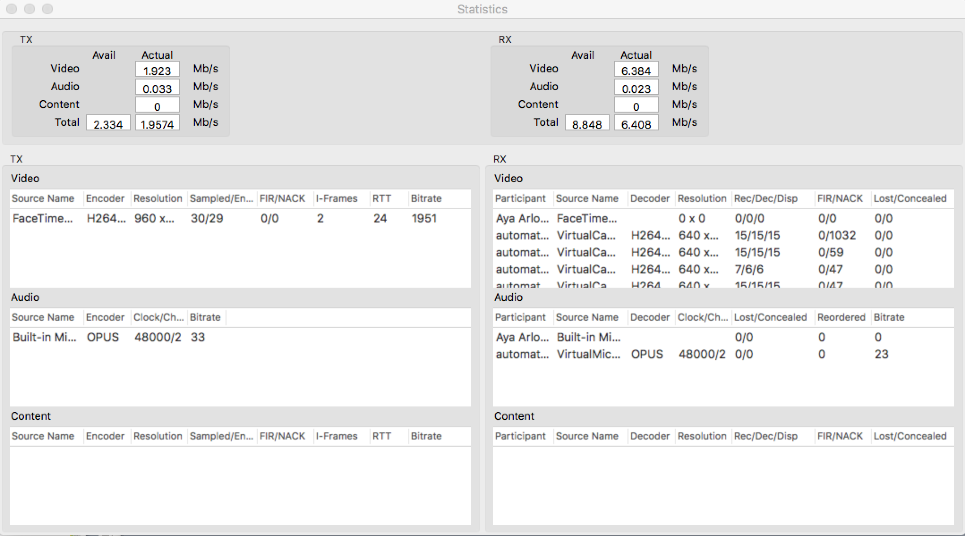
Audio Codec Negotiation

Slide 13
Statistics Dialog

Slide 14
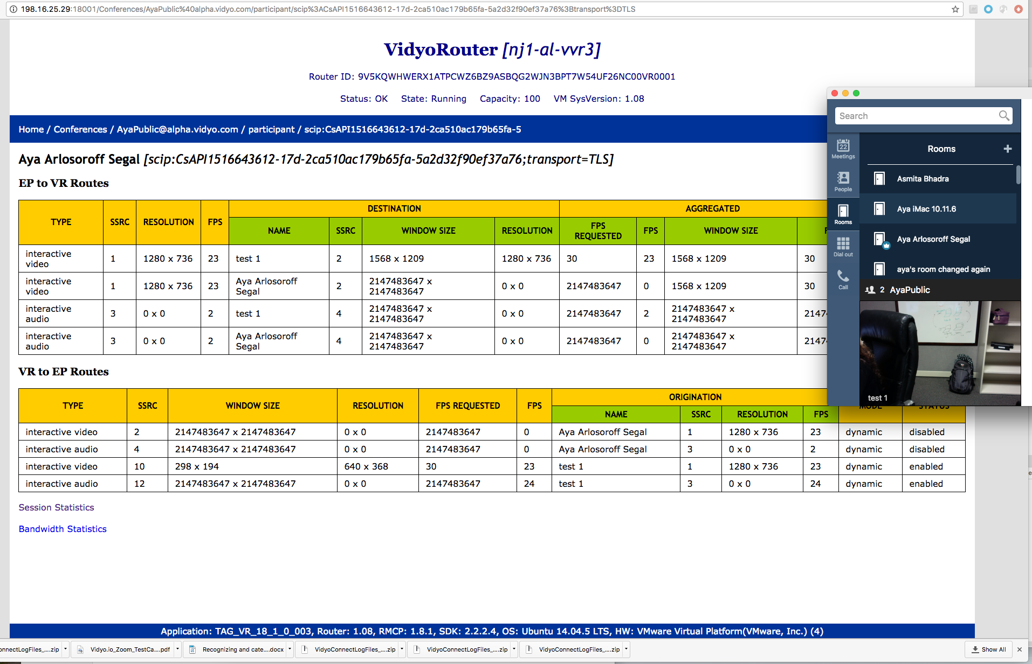
Reading the router page

Slide 15
Examples for discussion
Audio
https://jira.vidyo.com/browse/NEP-8722
https://jira.vidyo.com/browse/NEP-3907
Video
https://jira.vidyo.com/browse/VGW-2805

